Slide 1
Bivariate Data
Yr12 Applications unit 3

Slide 2
Contents (Mr Morgan added hyperlinks for your convenience)
Lesson 1: 2-way frequency tables
Lesson 2: types of variables
Lesson 3: Scatter graphs
Lesson 4: line of best fit
Lesson 5: Correlation Coefficient
Lesson 6: Causation vs Correlation
Lesson 7: Residuals and Residual plots
Lesson 8:Coefficient of determination

Slide 3
Overarching Syllabus points
3.1.1 review the statistical investigation process: identify a problem; pose a statistical question; collect or obtain data; analyse data; interpret and communicate results
3.1.16 write up the results of the above analysis in a systematic and concise manner
3.1.19 implement the statistical investigation process to answer questions that involve identifying, analysing and describing associations between two categorical variables or between two numerical variables
These points are covered in learning activities throughout lessons.

Slide 4
Lesson 1
Back to Contents
Topic: Frequency Tables
EQ: How do we use two-way frequency tables?
Syllabus points:
3.1.2 construct two-way frequency tables and determine the associated row and column sums and percentages
3.1.3 use an appropriately percentaged two-way frequency table to identify patterns that suggest the presence of an association
3.1.4 describe an association in terms of differences observed in percentages across categories in a systematic and concise manner, and interpret this in the context of the data

Slide 5
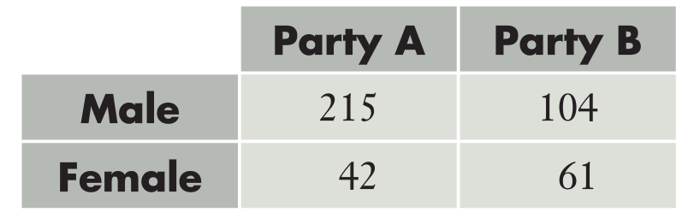
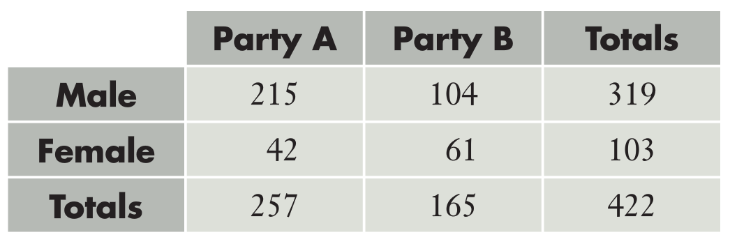
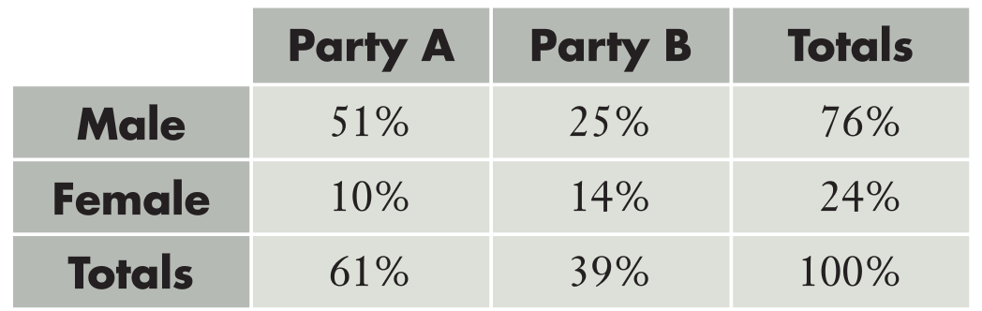
Topic: Frequency Tables
| EQ: How do we use two-way frequency tables?
Two Way Tables
Like Venn Diagrams (from year 10), two-way tables are a visual way of representing information. The below two-way table displays information about members of two political parties and their gender
On its own, we can only draw simple conclusions. We are going to explore how more nuanced displays will allow us to see if there is an association between the two variables
Adding totals allows us to see that Party A and B have more male MPs, and that Party A has more male MPs than Party B
Converting into proportions or percentages allows for more nuance. Now we can see:
51% of all the MPs from the two parties are males from party A
76% of all the MPs from these two parties are male

Slide 6
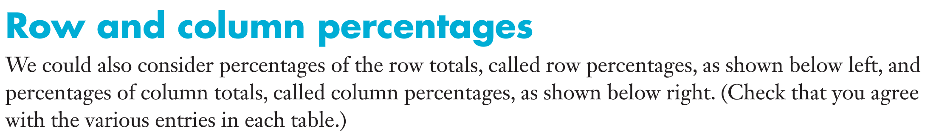
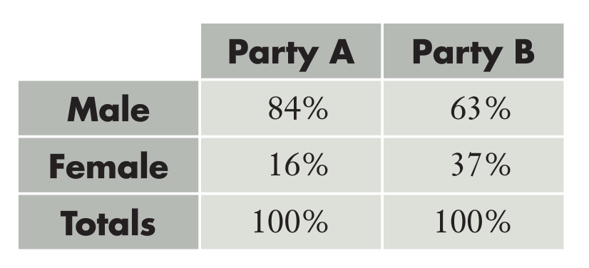
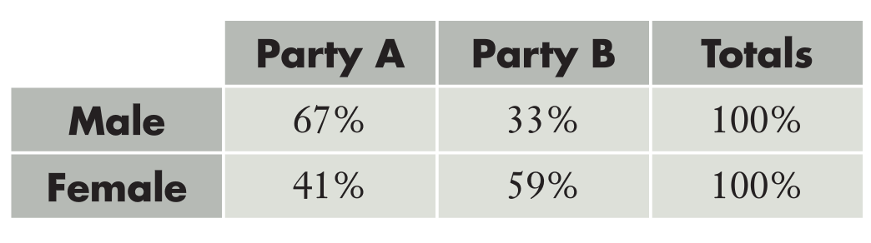
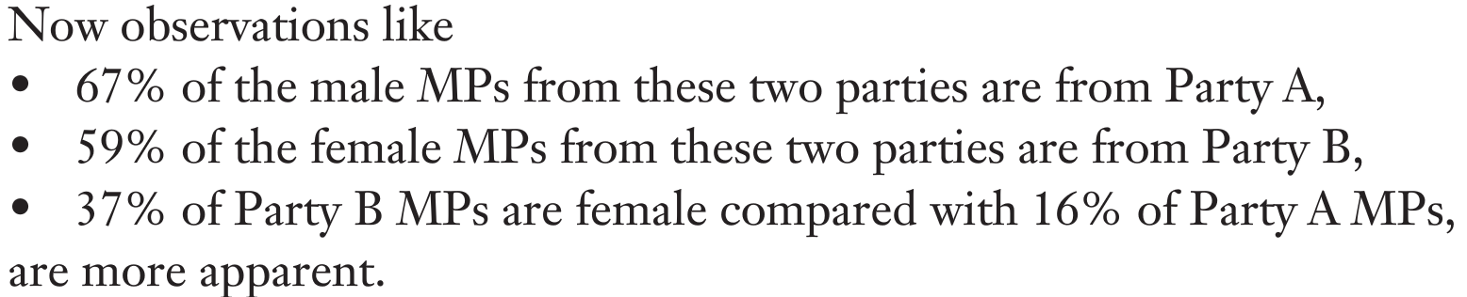

Slide 7
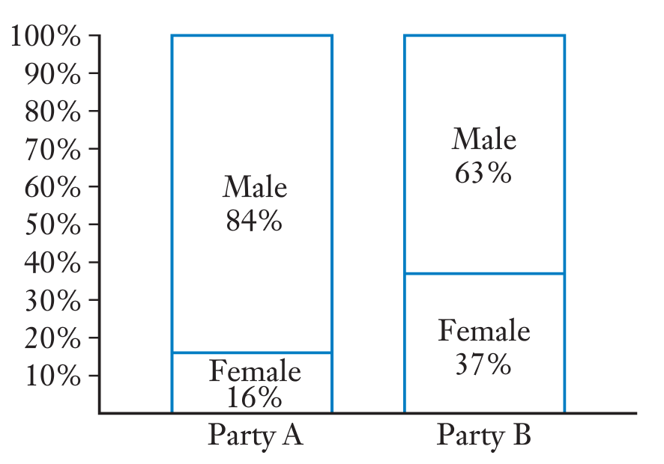
Finally, we can turn our two-way table into a proportional column graph (also referred to as a stacked 100% column graph)
Using these techniques, we can make deeper observations at every stage of the investigative process. From this proportional column graph we can say yes there is an association between these two variables

Slide 8
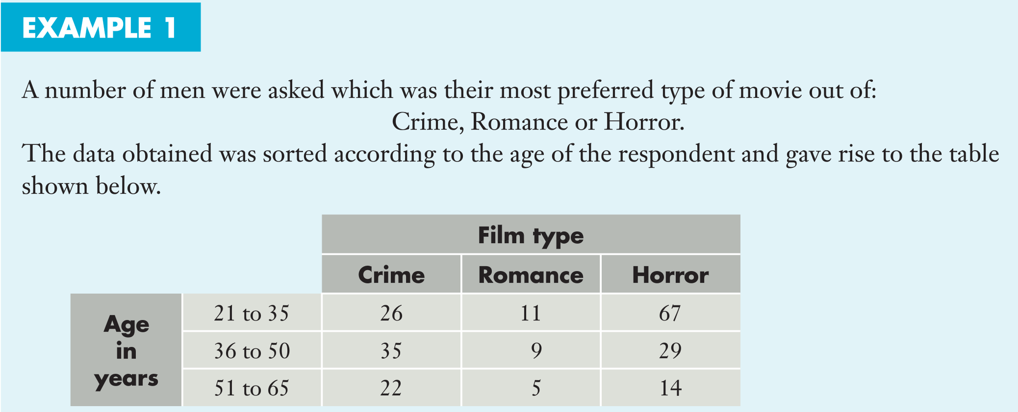
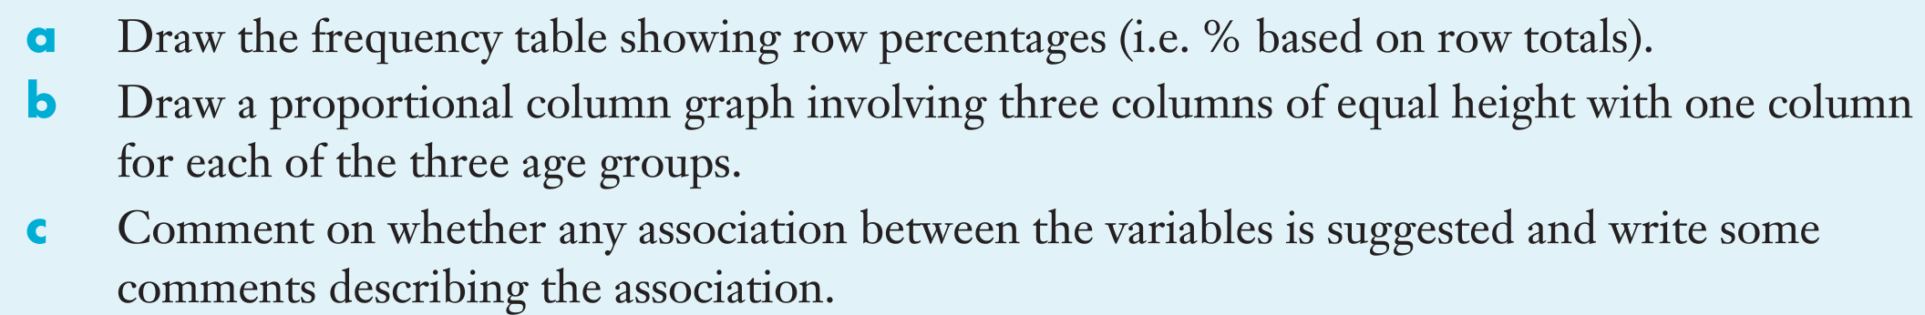

Slide 9
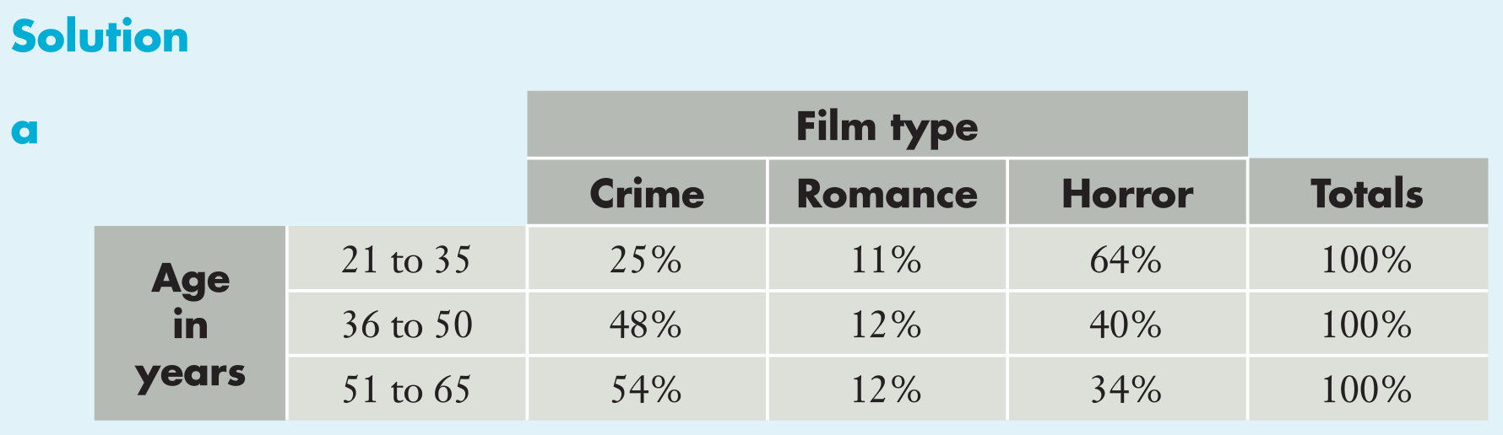
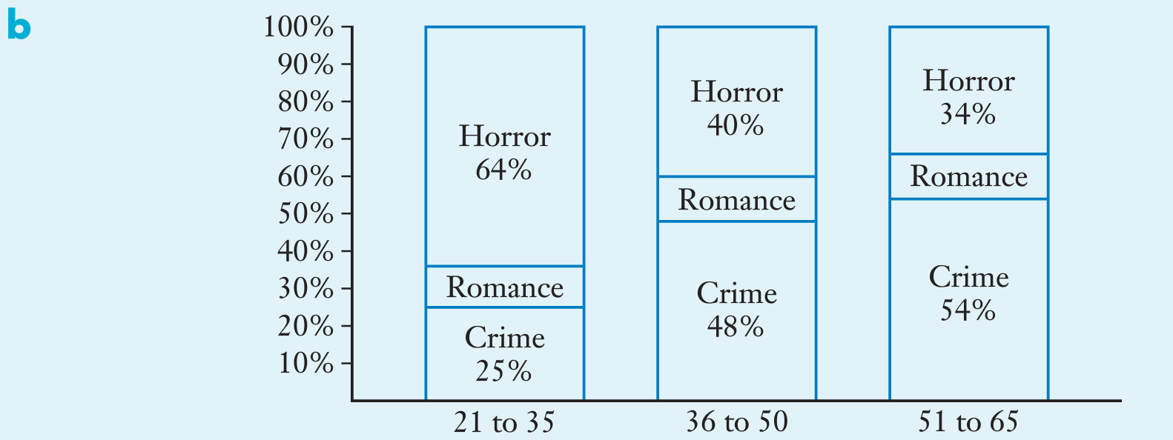
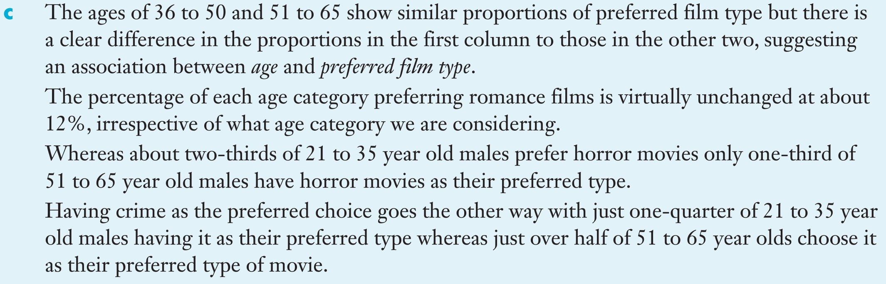

Slide 10
Complete Exercise 1A
Back to Contents

Slide 11
Lesson 2
Back to Contents
Topic: Variables
EQ: What is the difference between the response and explanatory variables?
Syllabus points:
3.1.3 use an appropriately percentaged two-way frequency table to identify patterns that suggest the presence of an association
3.1.4 describe an association in terms of differences observed in percentages across categories in a systematic and concise manner, and interpret this in the context of the data
3.1.8 identify the response variable and the explanatory variable for primary and secondary data

Slide 12
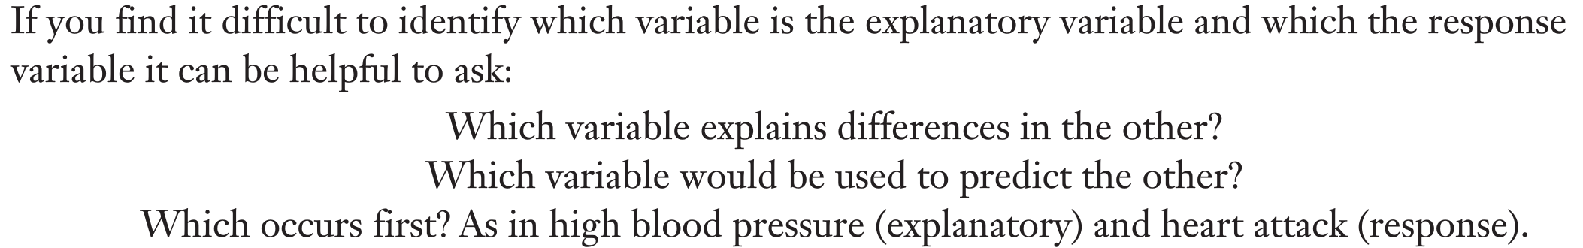
Topic: Variables| EQ: What’s the difference between the explanatory and response variable?
Explanatory variable = independent variable = X axis
Response variable = dependent variable = Y axis

Slide 13
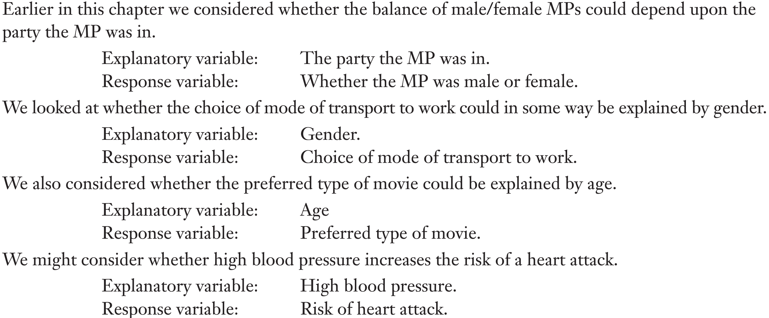
Examples

Slide 14
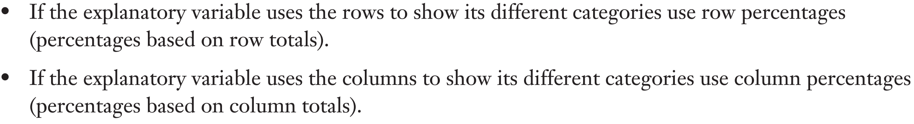
When to use row or column percentages
Deciding whether to use row percentages or column percentages depends on the explanatory variable.

Slide 15
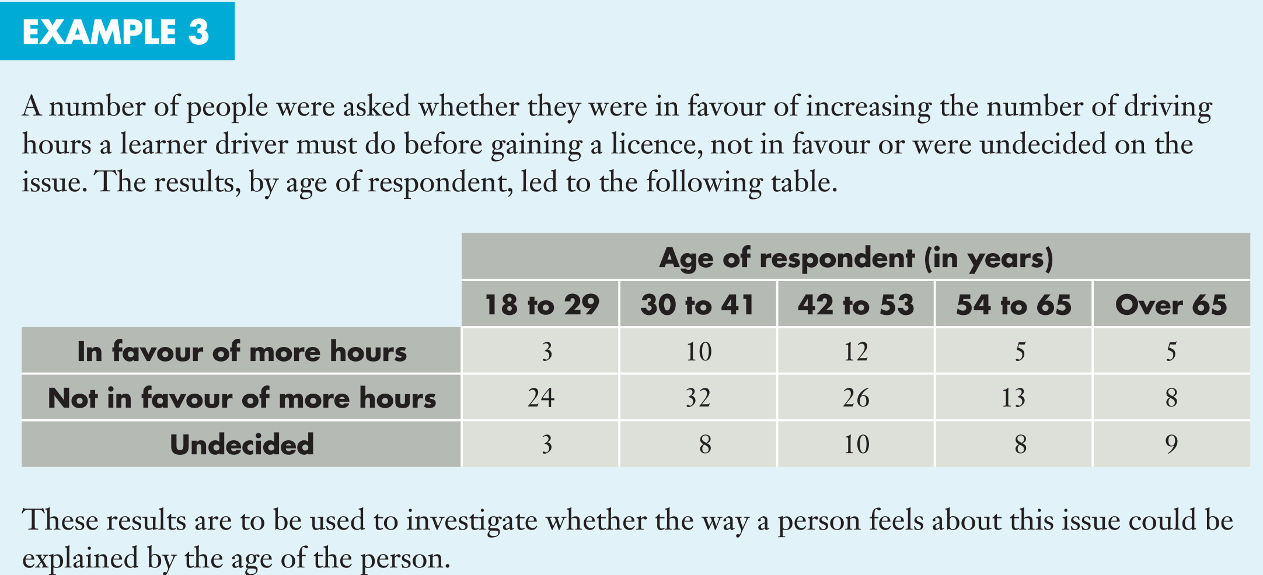
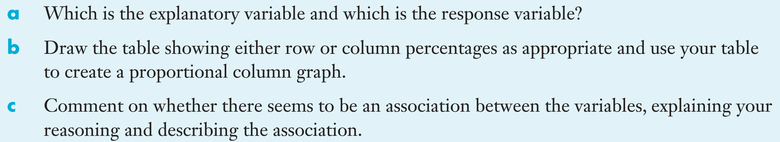
Example:

Slide 16
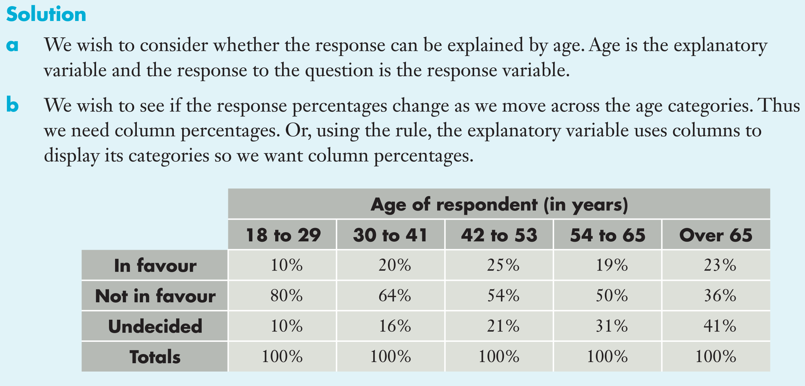
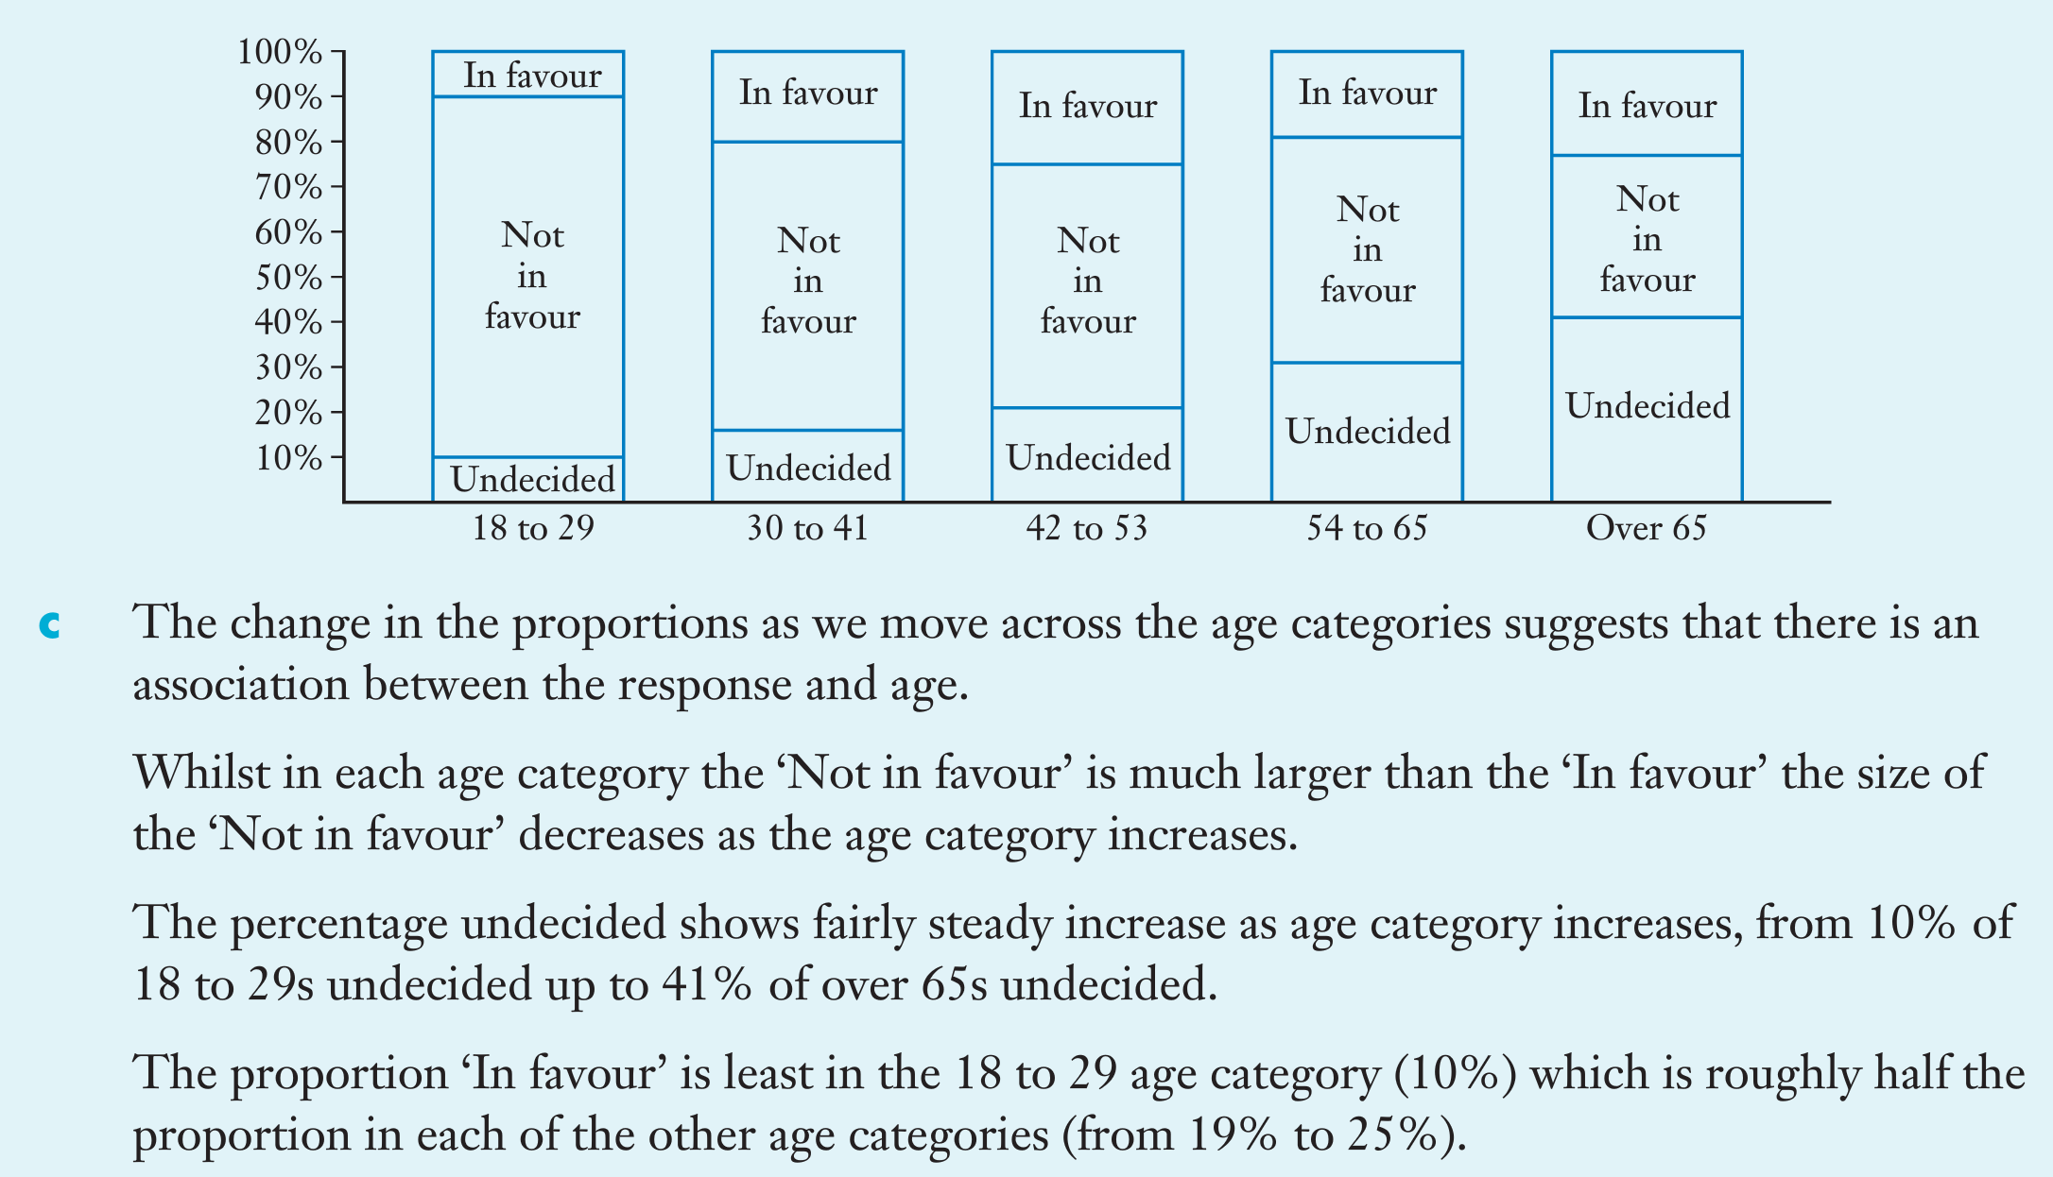

Slide 17
Complete Exercise 1B
Back to Contents

Slide 18
Lesson 3
Back to Contents
Topic: Scatter graphs
EQ: How can I display numerical data more suitably?
Syllabus points:
3.1.5 construct a scatterplot to identify patterns in the data suggesting the presence of an association
3.1.6 describe an association between two numerical variables in terms of direction (positive/negative), form (linear/non-linear) and strength (strong/moderate/weak)
3.1.9 use a scatterplot to identify the nature of the relationship between variables

Slide 19
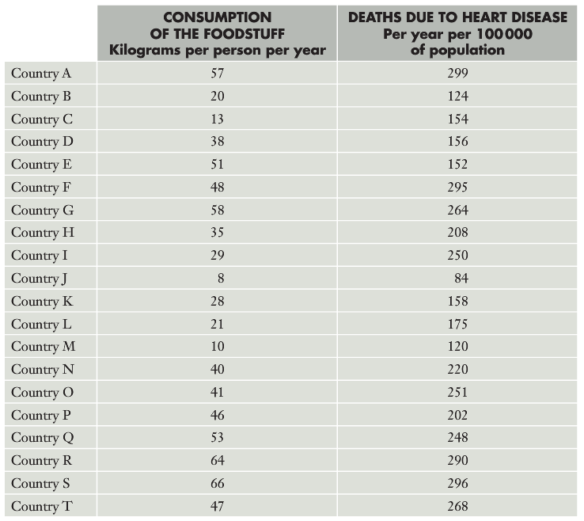
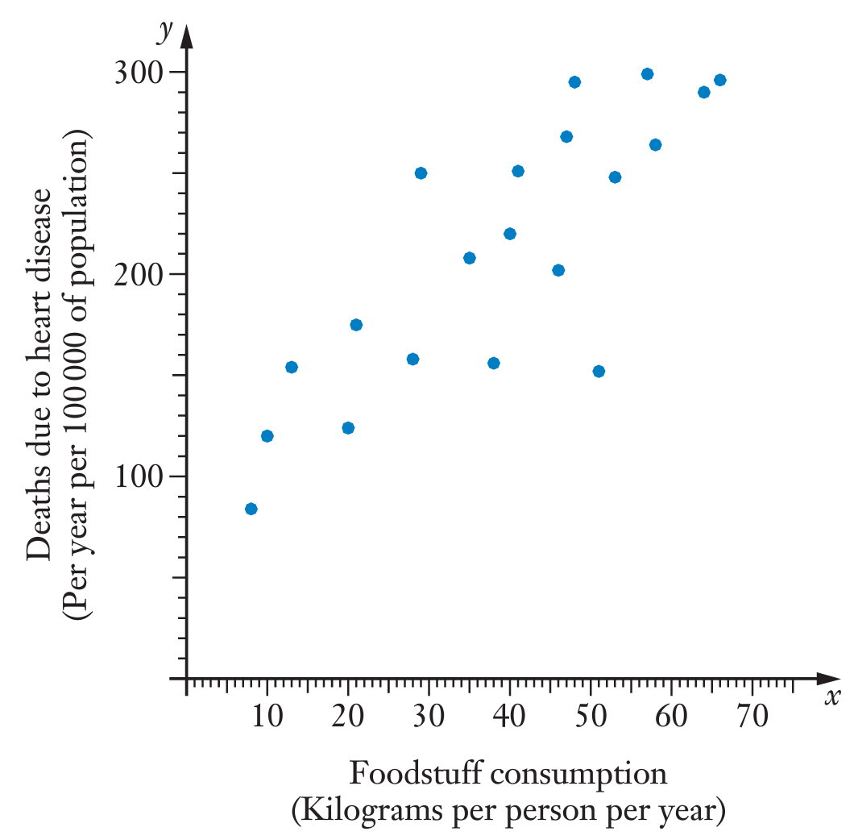
24
7
30
Date
Bivariate Data
EQ – How can I display numerical data more suitably?
This data can be displayed in a scatter graph. You can manually draw them or use your class pad

Slide 20
24
7
30
Date
Bivariate Data
EQ – How can I display numerical data more suitably?
Because both of these variables involve numerical data, a scattergraph, with one variable (explanatory) on the x-axis and the other variable (response) on the y-axis, is a more suitable.
Notice that the points tend to form an oval shape, from lower left to upper right
This indicates that in general, countries with a lower consumption of a particular food have lower deaths due to heart disease.
We can say that there seems to be and association or correlation between the foodstuff consumption and the death rate due to heart disease.
Using proper mathematical language, we can attempt to summarise and underlying pattern or trend suggested by the points. Not every point will fit the trend, but we can comment on the general behavior.

Slide 21
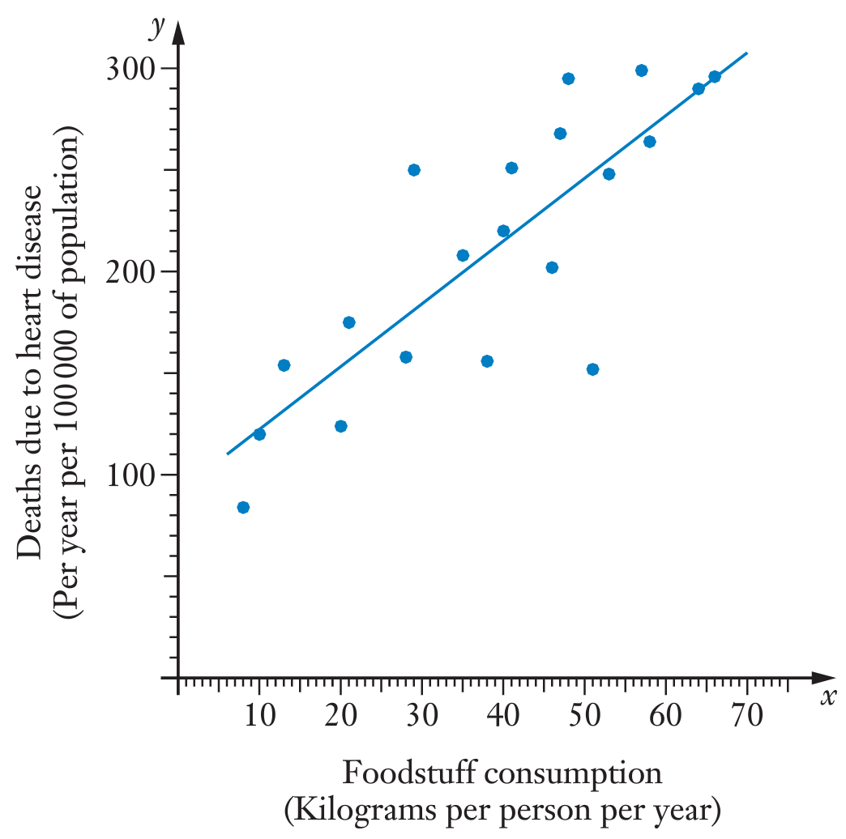
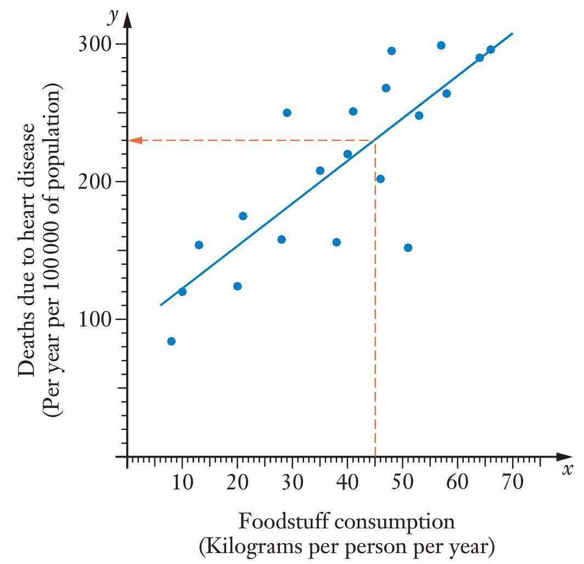
24
7
30
Date
Bivariate Data
EQ – How can I display numerical data more suitably?
Additionally, we could attempt to draw a straight line that seems to ‘best fit’ this data
In this way we could fit a linear model to the situation.
We can then use the model to make predictions.
For example, using our line of best fit, we could suggest that a country with an intake of 45kgs per person/yr of the particular food might have a heart disease death rate of approx. 230 persons per year per 100,000
Note: We tend to plot the explanatory (independent) variable on the horizontal axis and response (dependent) variable on the vertical axis

Slide 22
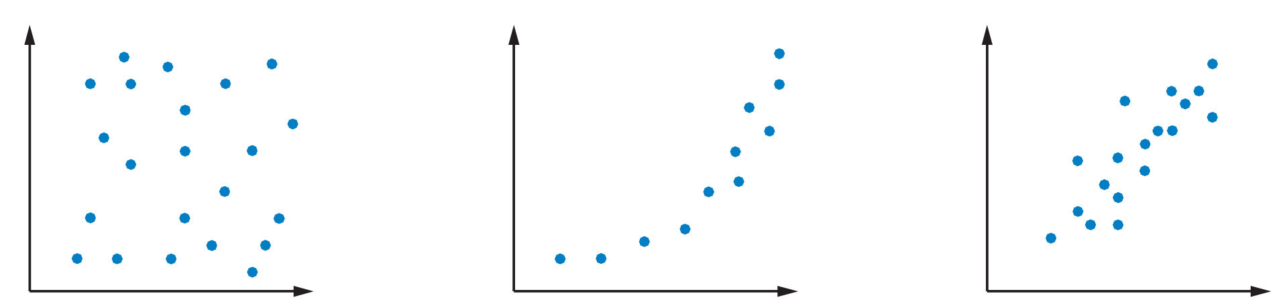
24
7
30
Date
Bivariate Data
EQ – How can I display numerical data more suitably?
How reliable are our predictions? Some things we need to consider are:
Does the distribution of points on the scatter graph suggest that using a linear model is a good idea, or should we perhaps use another model (which we’ll learn later)? Consider the following:
One of these graphs suggest using a linear model is appropriate, another suggest using a curve, while another shows no particular pattern.
How many points does the scatter graph involve. The more we have, the more confidence we have in our predictions.
How closely do the points fit a straight line? The closer the points are to a straight line, the better the linear model will be and the more confidence we can have in our predictions.

Slide 23
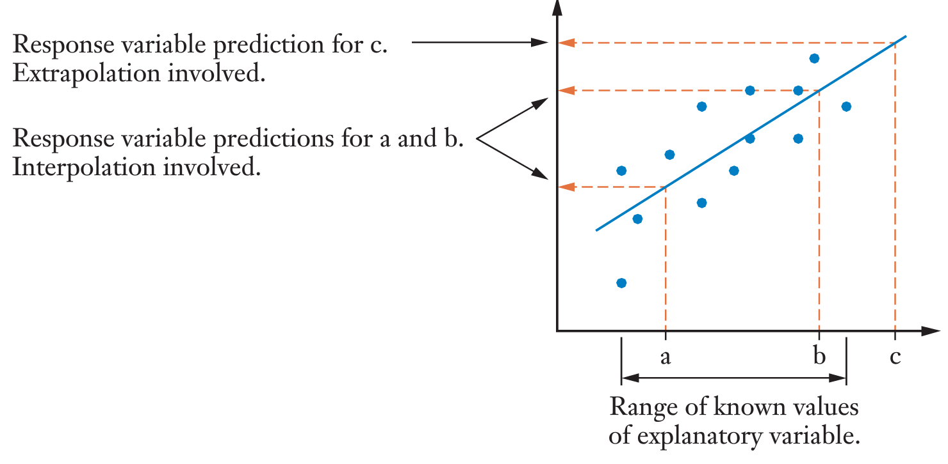
24
7
30
Date
Bivariate Data
EQ – How can I display numerical data more suitably?
Finally, we need to consider: Are we making a prediction for a value that lies within or without the spread of our known values? I.e – does our prediction involve interpolation (between the given points) or extrapolation (beyond the given points)? Predictions involving extrapolation are likely to be less reliable.

Slide 24
24
7
30
Date
Bivariate Data
EQ – How can I display numerical data more suitably?
Let’s apply all of this to our earlier prediction that a country with a consumption of 45kg of a particular foodstuff will have a death rate due to heart disease of approx. 230 deaths per year per 100,000 people:
We can be reasonably confident in this prediction because:
The graph does suggest a linear model could be appropriate
The graph involves a reasonable number of data points
The figure of 45kg/person per year is within the values covered by the given data, therefore interpolation is involved

Slide 25
24
7
30
Date
Bivariate Data
EQ – How can I display numerical data more suitably?
Please complete Sadler Unit 3 Exercise 1C (odd numbers only) in class and Miscellaneous Exercise 1 for homework

Slide 26

Well done on completing chapter 1
Back to Contents

Slide 27
Lesson 4
Back to Contents
Topic: Lines of best fit
EQ: How can we interpret the values in a line of best fit?
Syllabus points:
3.1.5 construct a scatterplot to identify patterns in the data suggesting the presence of an association
3.1.6 describe an association between two numerical variables in terms of direction (positive/negative), form (linear/non-linear) and strength (strong/moderate/weak)
3.1.10 model a linear relationship by fitting a least-squares line to the data
3.1.12 interpret the intercept and slope of the fitted line
3.1.14 use the equation of a fitted line to make predictions
3.1.15 distinguish between interpolation and extrapolation when using the fitted line to make predictions, recognising the potential dangers of extrapolation

Slide 28
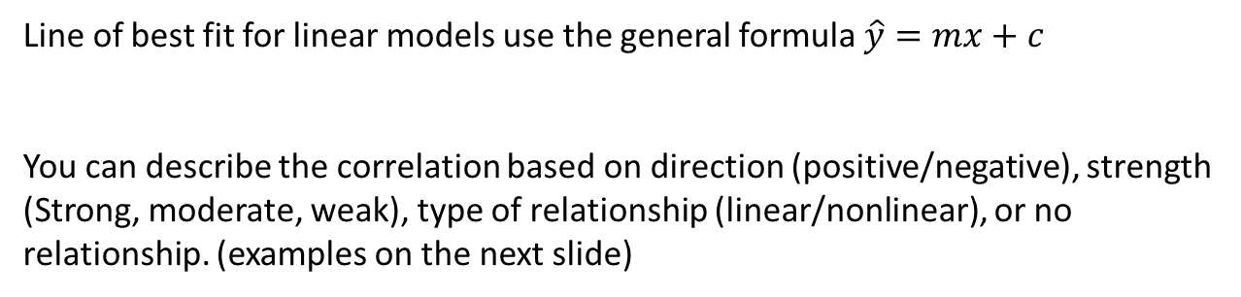
24
7
30
Date
Line of best fit
EQ –How can we interpret the values in a line of best fit?
Line of best fit for linear models use the general formula $\hat{y}=mx+c$
You can describe the correlation based on direction (positive/negative), strength (Strong, moderate, weak), type of relationship (linear/nonlinear), or no relationship. (examples on the next slide)

Slide 29
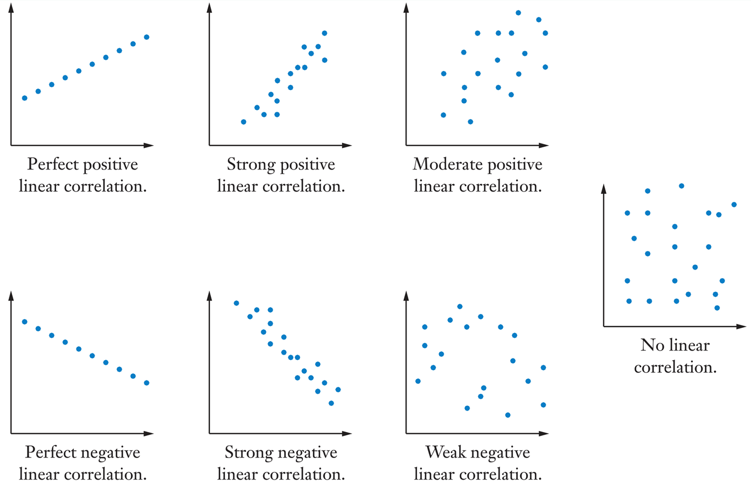

Slide 30

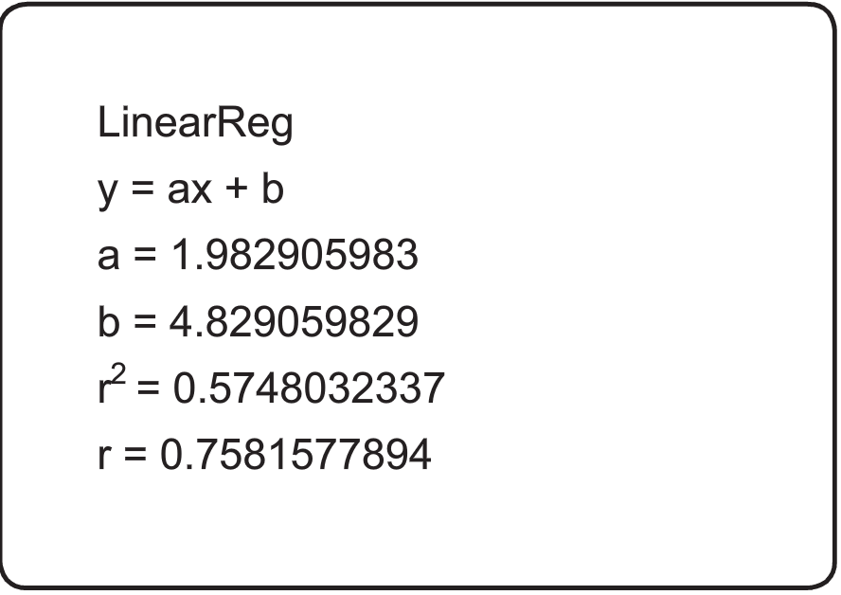

Example
Physics | 6 | 9 | 11 | 12 | 14 | 14 | 16 | 16 | 17 | 19
Maths | 19 | 12 | 27 | 36 | 42 | 34 | 32 | 27 | 44 | 41
Steps
Enter data into classpad in statistics (list 1 is physics, list 2 is maths)
Calc -> regression -> Linear reg
Write out equation $\hat{y}=ax+b$
$$\hat{y}=1.98x+4.83$$
You can use this equation to make predictions.
You can also describe what is happening in the context of the question
The 1.98 shows it is a positive correlation, so for every mark increase in physics the maths score goes up by 1.98. the +4.83 suggests that a student who got zero on the physics test would be predicted to get 4.83 on the math test.

Slide 31
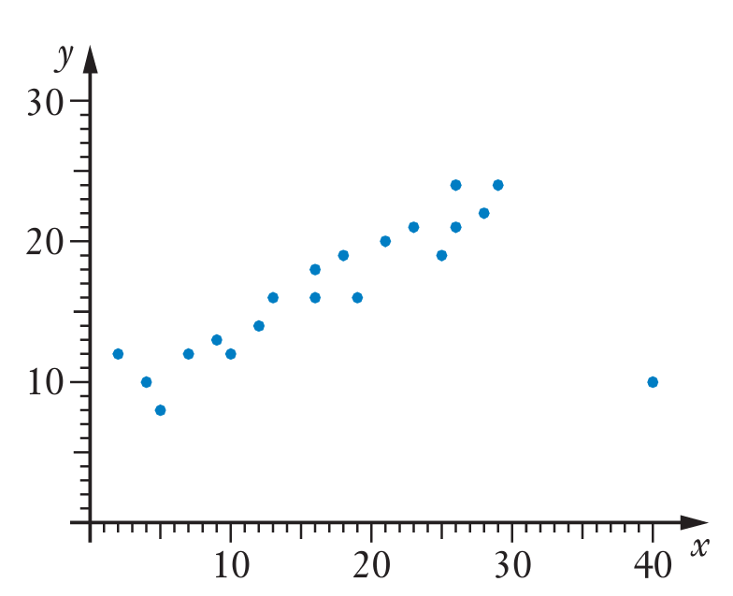
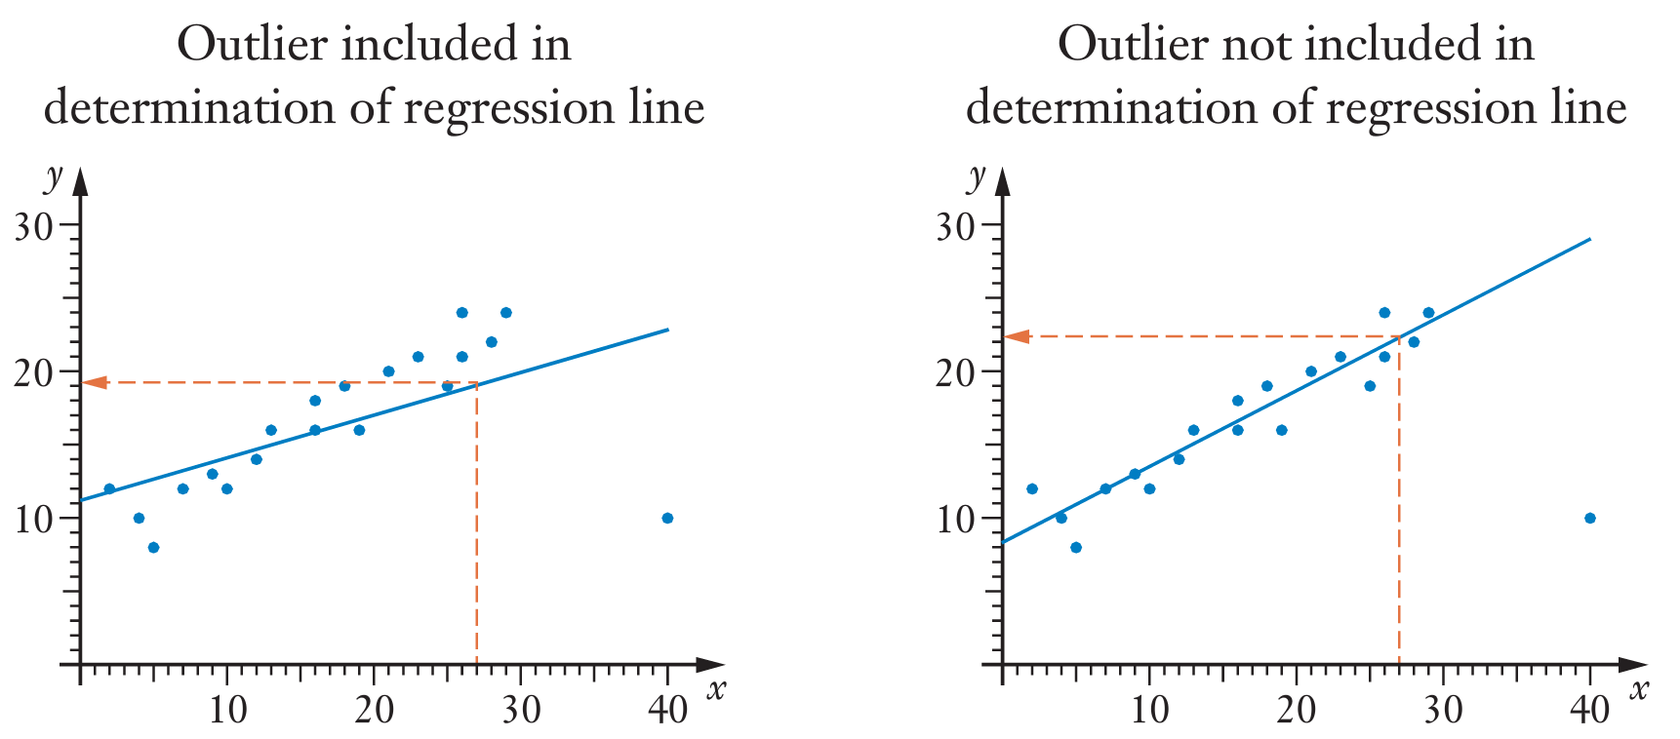
Outliers and “trimming” or “cropping” Data
Outliers can dramatically affect the line of best fit in your calculator.

Slide 32
Can we remove outliers?
You can remove outliers, but it is important to give reasons as to why you have removed them. An outlier may have been a mistake in data collection, but it could also be a valid data point.

Slide 33
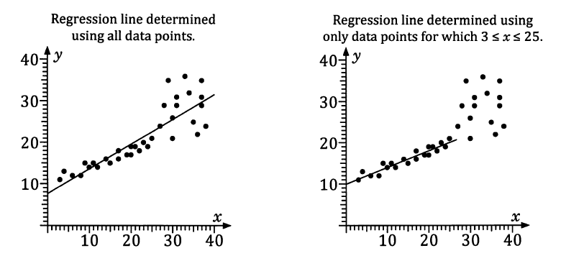
Cropping or trimming data
This is done when a strong relationship is present for part of the data, but not after or before a certain data range.
The purpose is to make a stronger relationship, making predictions in that data range more accurate.

Slide 34
Complete exercise 2A please
Back to Contents

Slide 35
Lesson 5
Back to Contents
Topic: correlation coefficient
EQ: What is correlation coefficient and what does it do?
Syllabus points:
3.1.7 calculate, using technology, and interpret the correlation coefficient (r) to quantify the strength of a linear association

Slide 36
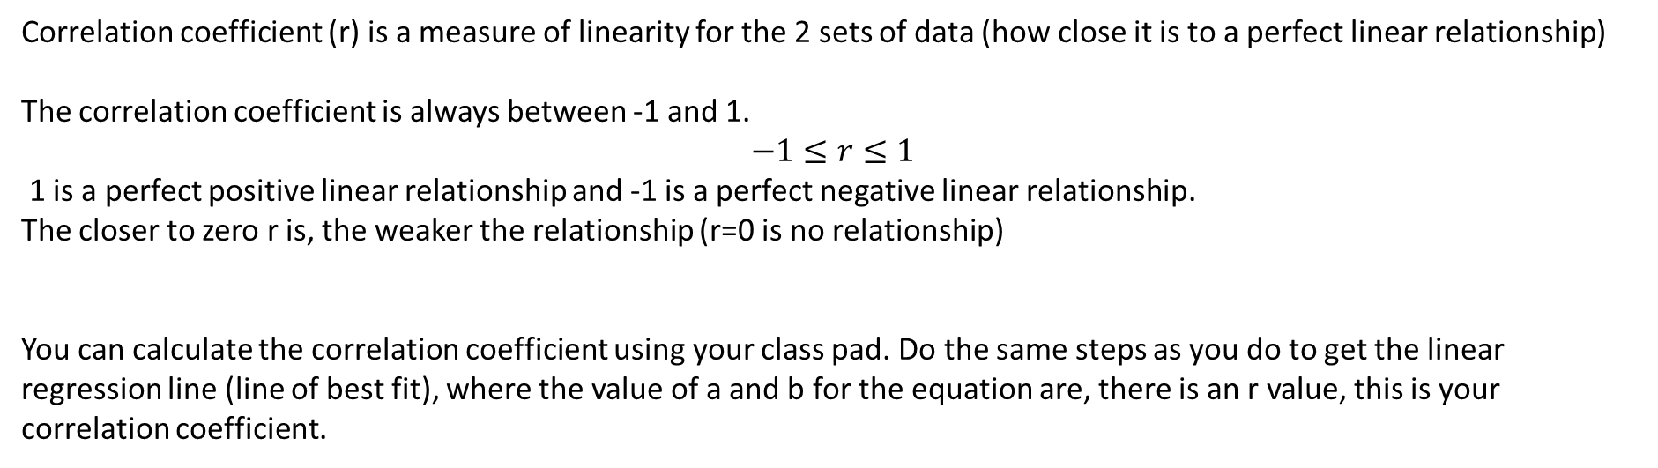
24
7
30
Date
Correlation coefficient
EQ –What is correlation coefficient and what does it do?
Correlation coefficient (r) is a measure of linearity for the 2 sets of data (how close it is to a perfect linear relationship)
The correlation coefficient is always between -1 and 1.
$$−1≤r≤1$$
1 is a perfect positive linear relationship and -1 is a perfect negative linear relationship.
The closer to zero r is, the weaker the relationship (r=0 is no relationship)
You can calculate the correlation coefficient using your class pad. Do the same steps as you do to get the linear regression line (line of best fit), where the value of a and b for the equation are, there is an r value, this is your correlation coefficient.
Steps
Enter data into class pad in statistics (list 1 is physics, list 2 is maths)
Calc -> regression -> Linear reg
Write out r value

Slide 37
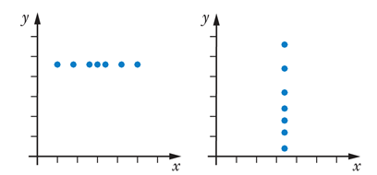
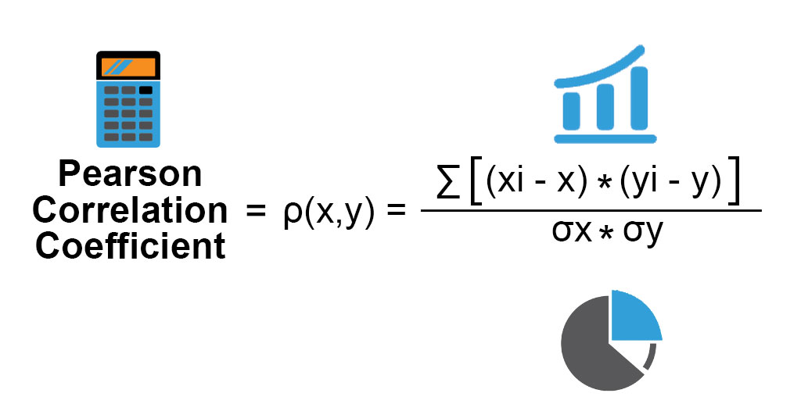
Fun fact 1: the graphs to the side correlation coefficient is irrelevant even though they are straight lines. If lines are vertical or horizontal they are not bivariate data. It is saying x= a(vertical line) specific value and same with y (horizontal line)
Fun Fact 2:

Slide 38
24
7
30
Date
Correlation coefficient
EQ –What is correlation coefficient and what does it do?
What does the correlation coefficient tell us?
It helps tell us how reliable a prediction is. The stronger the relationship (r is closer to 1 or -1) the more accurate predictions are using the line of best fit. Make sure you also mention extrapolation or interpolation if asked to comment on a prediction with the correlation coefficient.
Key points:
Closer to 1 or -1 r is the more accurate predictions are
Extrapolation: prediction outside data range, not reliable
Interpolation: Prediction inside data range, is reliable.

Slide 39
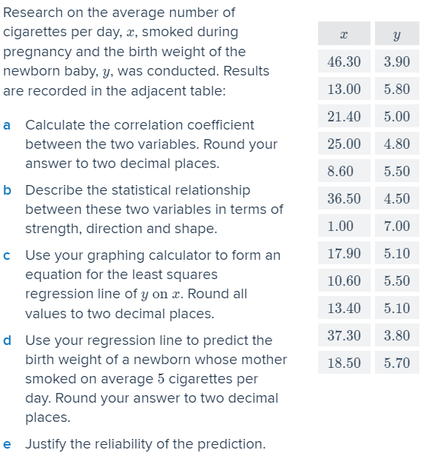
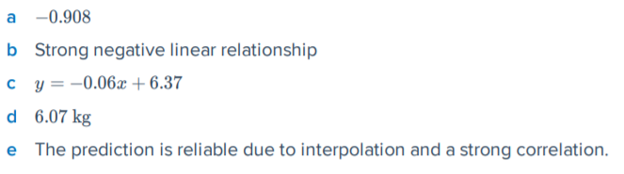
Example
Answers

Slide 40
Complete exercise 2B please

Slide 41
Lesson 6
Back to Contents
Topic: Causation
EQ: Does correlation equal causation?
Syllabus points:
3.1.17 recognise that an observed association between two variables does not necessarily mean that there is a causal relationship between them
3.1.18 identify possible non-causal explanations for an association, including coincidence and confounding due to a common response to another variable, and communicate these explanations in a systematic and concise manner

Slide 42
24
7
30
Date
Causation
EQ –Does correlation equal causation?
Correlation DOES NOT equal Causation
I repeat
Correlation DOES NOT equal Causation

Slide 43
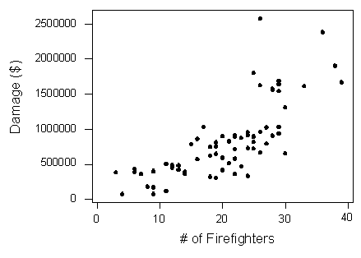
Example:
The Scatter plot to the side shows the relationship between the number of firefighters sent to a fire (x) and the amount of damage caused by the fires (y) in a certain city.
The graph shows a positive association with a moderate strength. An increase in the number of fire fighters is associated with an increase in fire damage.
Can we conclude that the increase in firefighters causes the increase in damage?

Slide 44
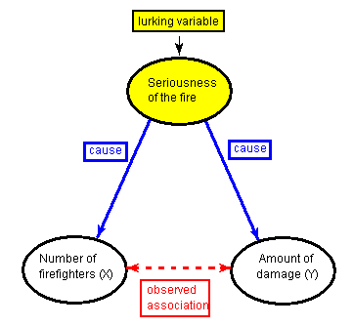
Example:
The Scatter plot to the side shows the relationship between the number of firefighters sent to a fire (x) and the amount of damage caused by the fires (y) in a certain city.
The graph shows a positive association with a moderate strength. An increase in the number of fire fighters is associated with an increase in fire damage.
Can we conclude that the increase in firefighters causes the increase in damage?
No you cannot
The number of firefighters sent to a fire is based on the seriousness of the fire. This also would be a reason for the damage to be higher.

Slide 45
24
7
30
Date
Causation
EQ –Does correlation equal causation?
Correlation DOES NOT equal Causation
Lurking variables: variables that are in the background.
You cannot state a causation relationship from a scatterplot alone, because there can be underlying variables that could be the actual cause.

Slide 46
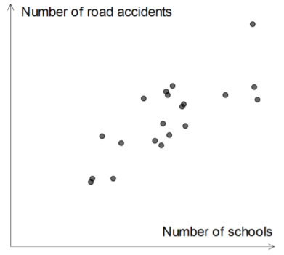
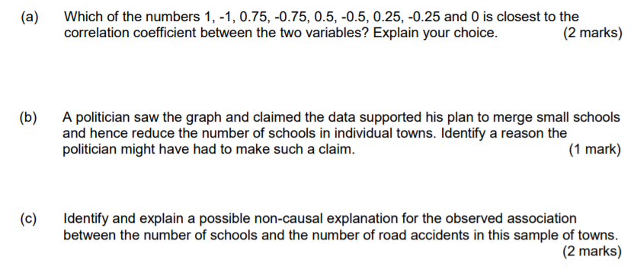

Slide 47
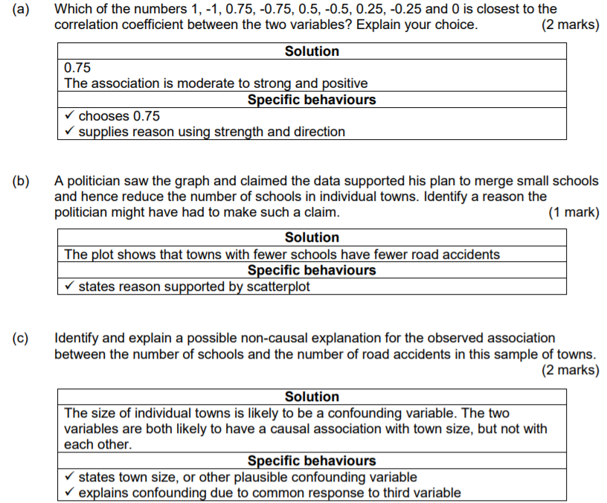

Slide 48
Complete the following work
KLUP Association and Causation

Slide 49
Lesson 7
Back to Contents
Topic: Residuals
EQ: What is the purpose of residuals and residual plots?
Syllabus points:
3.1.11 use a residual plot to assess the appropriateness of fitting a linear model to the data

Slide 50
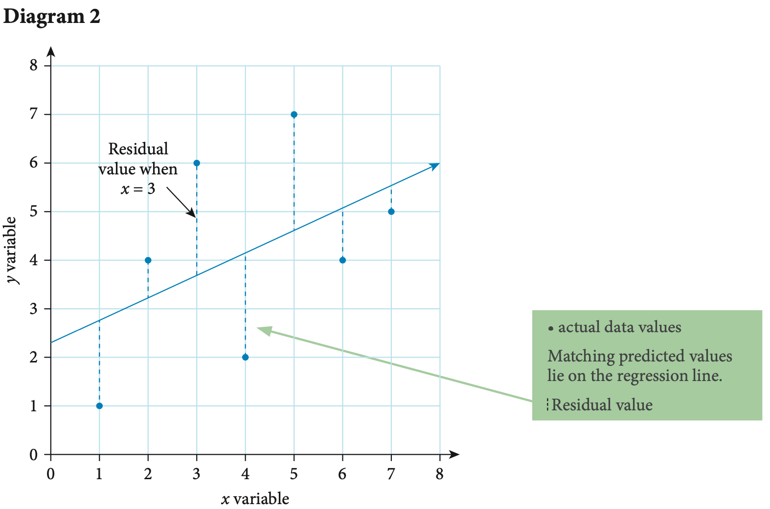
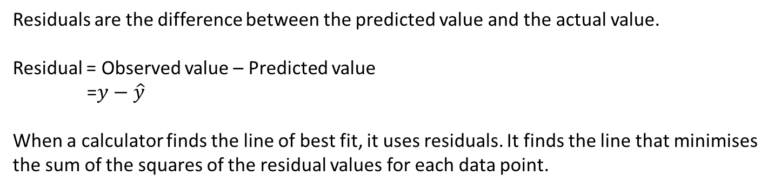
Residuals
How is the line of best fit calculated?
Residuals are the difference between the predicted value and the actual value.
Residual = Observed value – Predicted value
=$y−\hat{y}$
When a calculator finds the line of best fit, it uses residuals. It finds the line that minimises the sum of the squares of the residual values for each data point.
Important
Residual = actual y value – predicted y value
The actual y value can either be stated, be found in the data table or read from a scatter plot
The predicted y value needs to be calculated using the linear regression model for the data

Slide 51
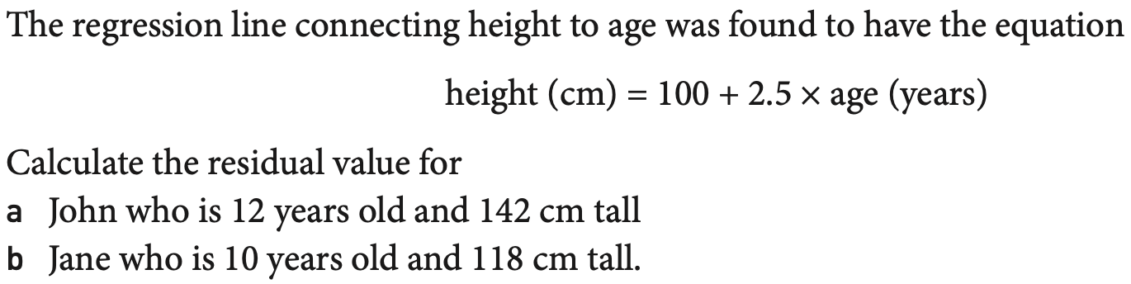
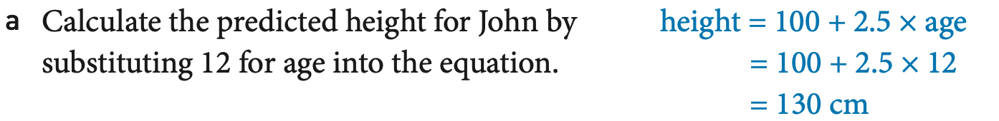
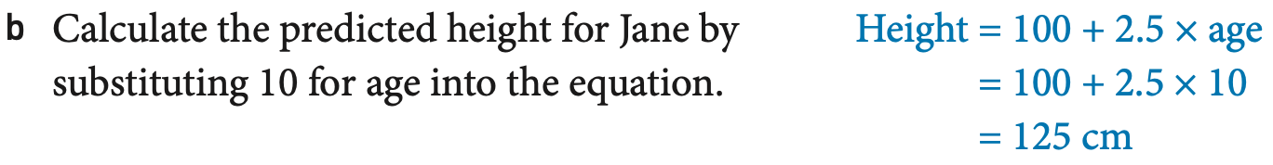
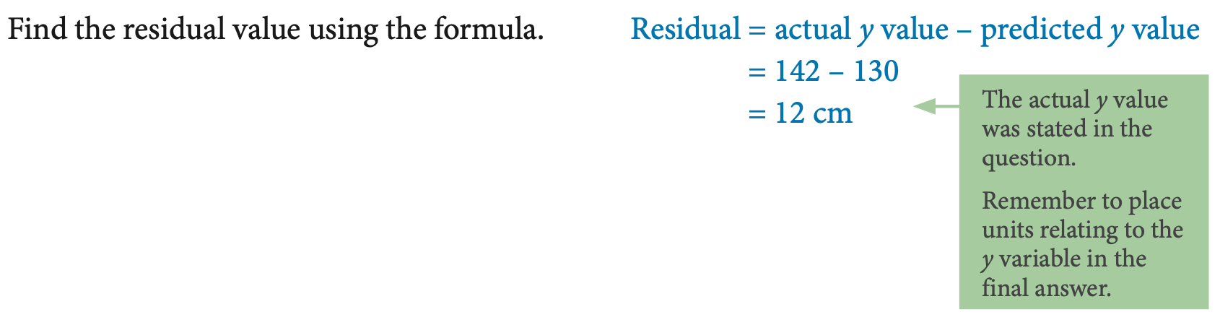
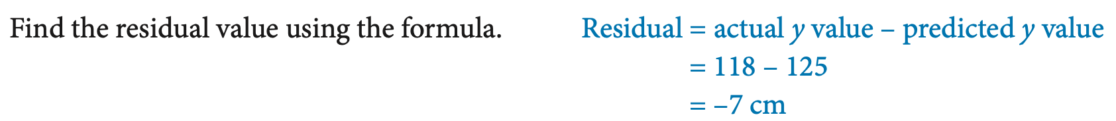
Example:

Slide 52

Residual Plots
A Residual Plot is a scatterplot of the regression residuals against the explanatory variable.
They help us assess the fit of a regression line.
If the regression line captures the overall relationship between x and y, the residuals should have no systematic pattern.
The uniform scatter of points indicates that the regression line fits the data well, so the line is a good model.

Slide 53


A curved pattern shows that the relationship is not linear.
Increasing or decreasing spread about the line. The response variable y has more spread for larger values of the explanatory variable x, so the prediction will be less accurate when x is large.

Slide 54


Slide 55
work
KLUP residuals

Slide 56
Lesson 8
Back to Contents
Topic: Coefficient of Determination
EQ:?
Syllabus points:
3.1.13 use the coefficient of determination to assess the strength of a linear association in terms of the explained variation

Slide 57

Coefficient of Determination
The coefficient of determination $(r^{2})$ is the correlation coefficient squared.
It tells the percentage of the variation in the response variable that is explained (determined) by the model and the explanatory variable

Slide 58

Example
Example: r² =0.927
as a percentage this is 92.7%
Interpretation:
Almost 93% of the variability in the amount of water consumed is explained by outside temperature using this model.
Note: Therefore 7% of the variation in the amount of water consumed is not explained by this model using temperature.

Slide 59



Here we have a perfect correlation, or r =1
R² is also 1
This means that 100% of the variation in the cooking time is explained, or accounted for, by the relationship between the two variables (cooking time and weight)
Here we have a correlation coefficient, of r = 0.823
R² = 0.677
This means that approx. 68% of the variation in death rates due to heart disease can be explained by the variation in foodstuff consumption

Slide 60





Slide 61
Complete the following
KLUP coefficient of determination

Slide 62
Congratulations on finishing Bivariate Data notes
Make sure you are using your WACE study guide for exam style question practice.

